Slide 1
Internship Studio-Task3
Vulnerability Report

Slide 2
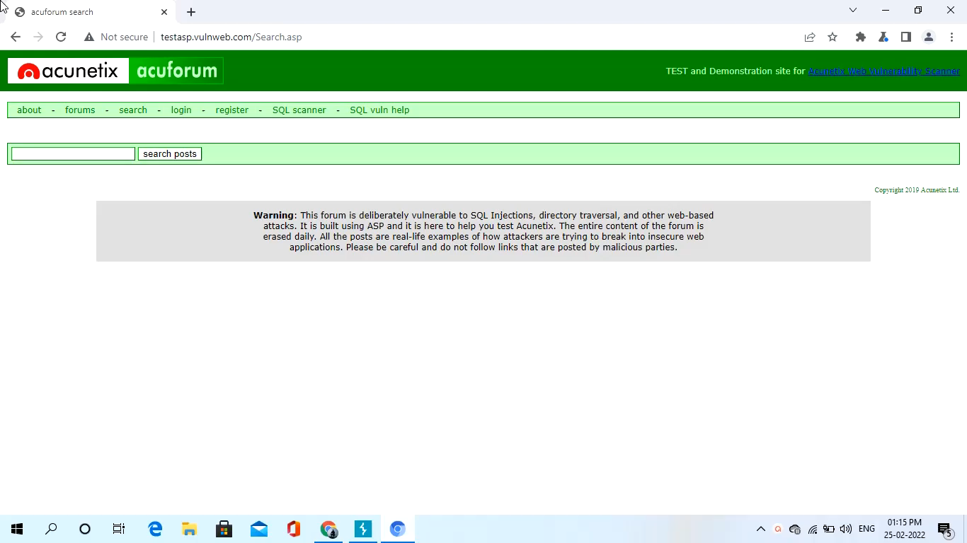
POC Video

Slide 3
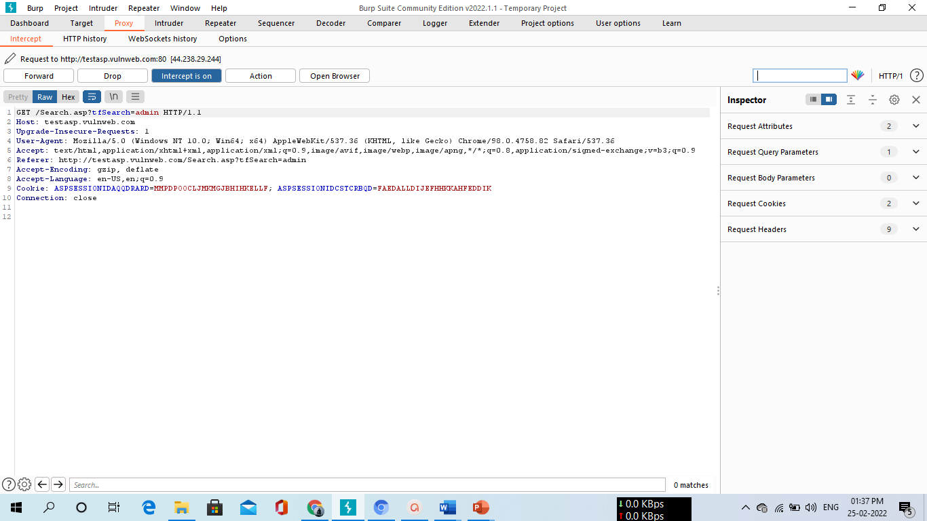
Screenshots

Slide 4
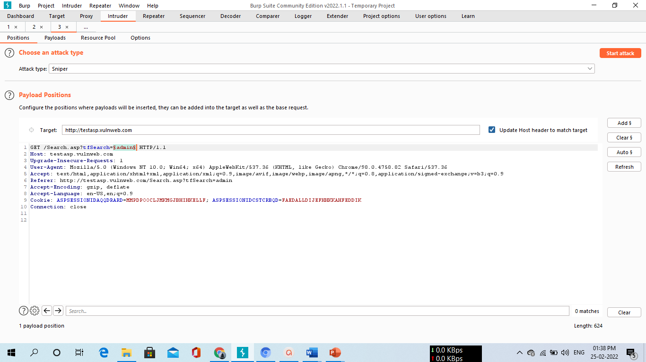
Screenshots

Slide 5
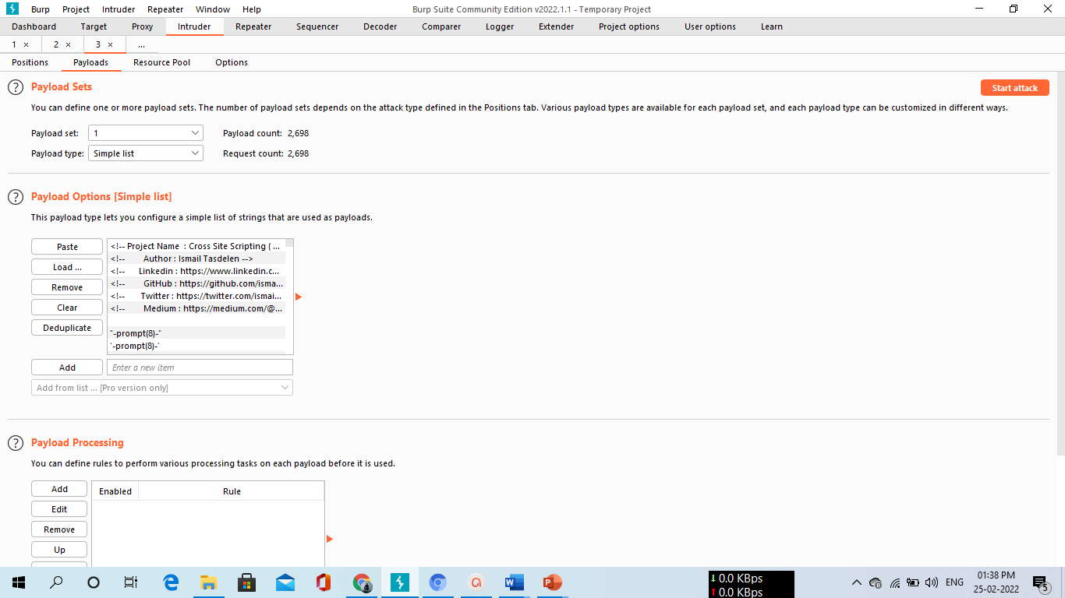
Screenshots

Slide 6
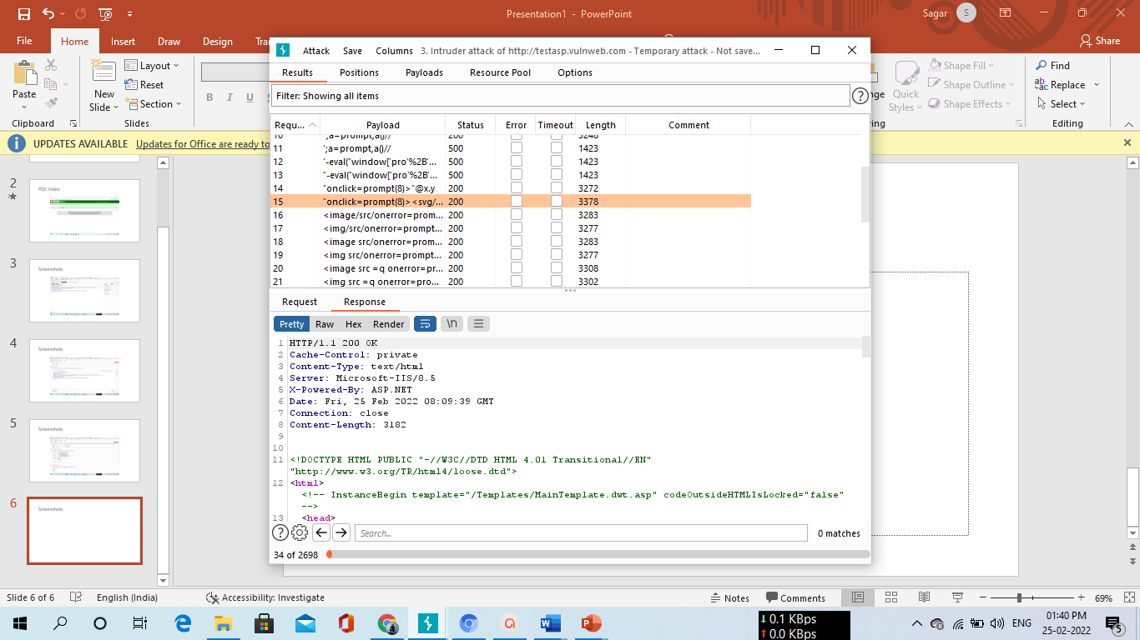
Screenshots

Slide 7
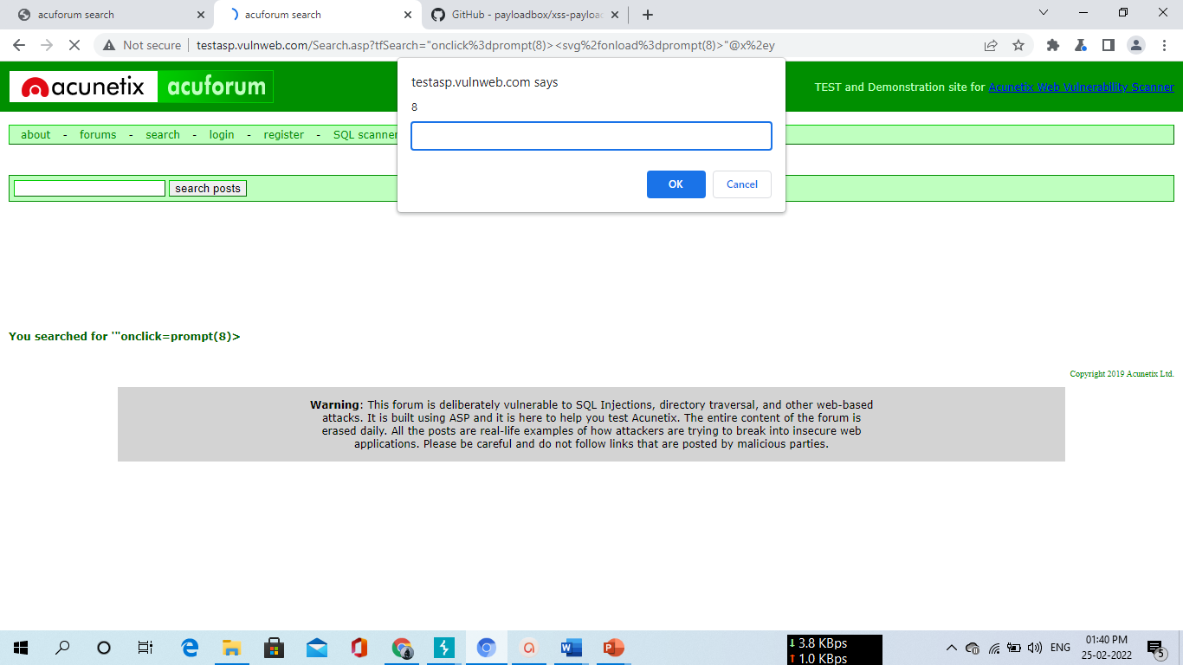
Screenshots

Slide 8
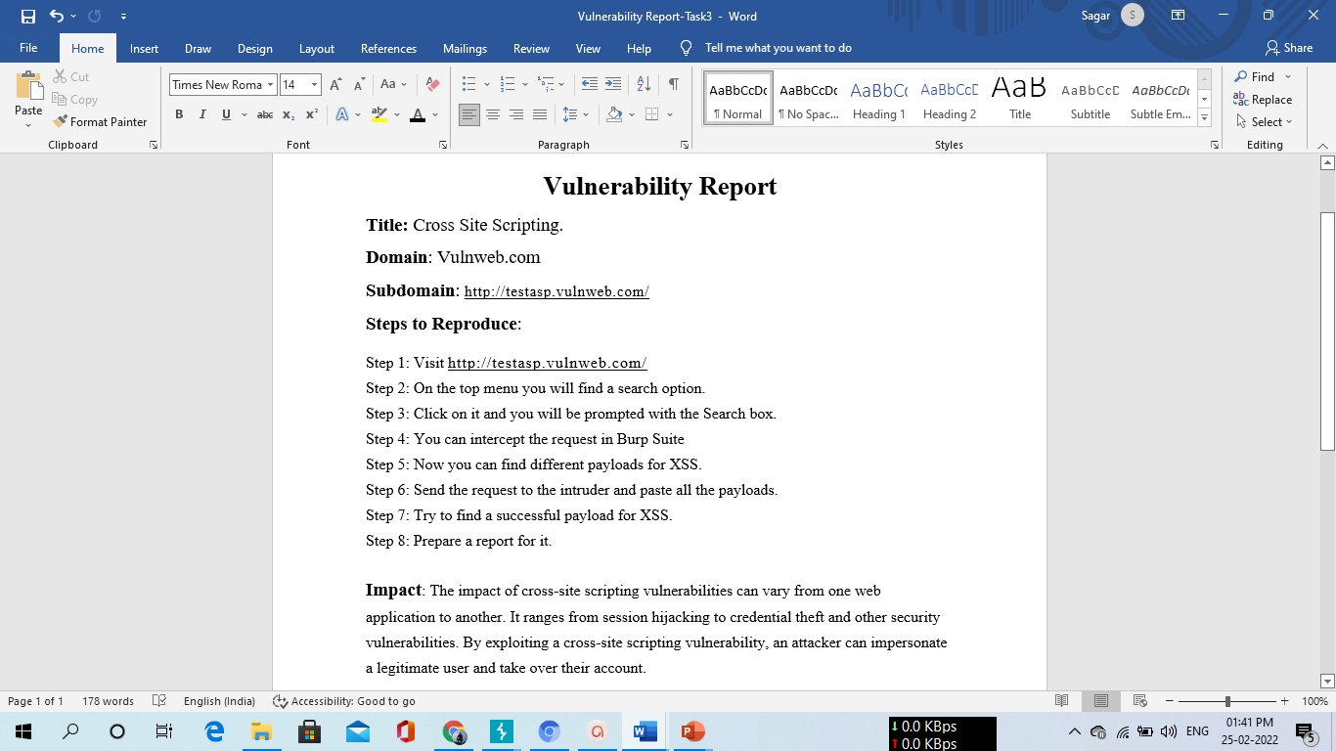
Vulnerability Report

Slide 9
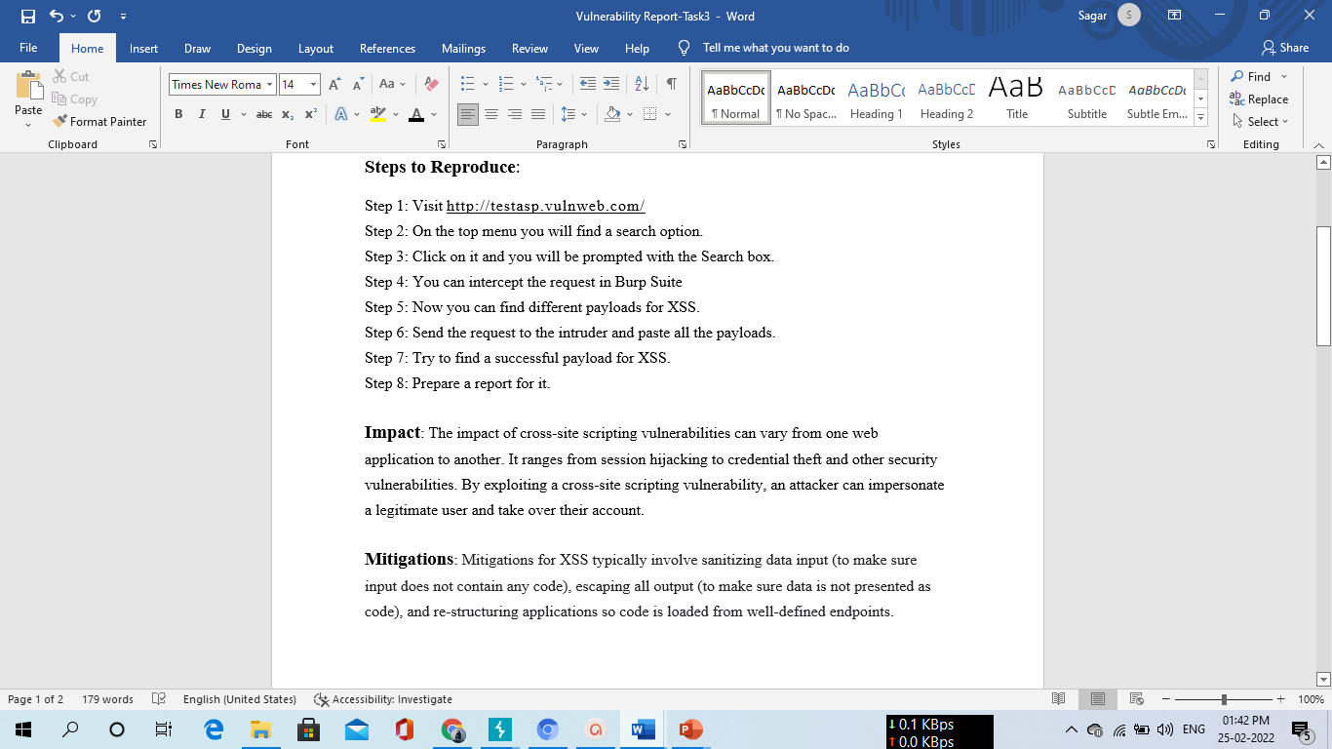
Vulnerability Report

Slide 10
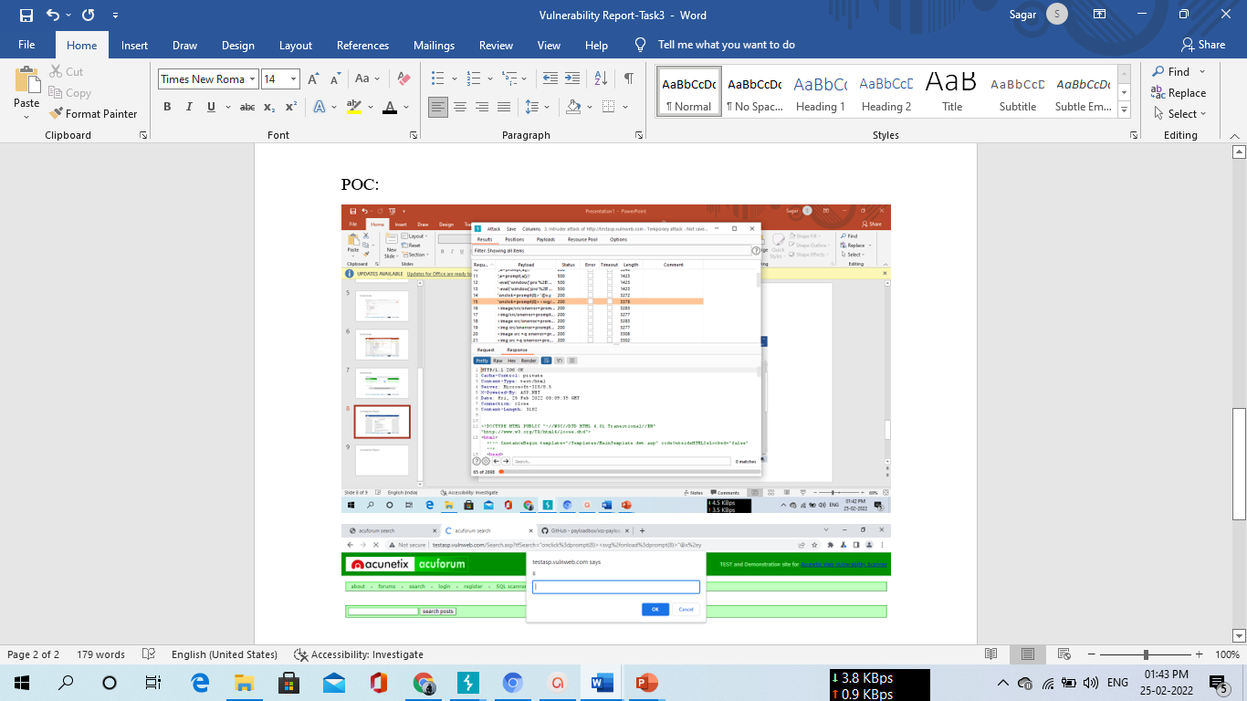
Vulnerability Report

